Slide 1


Case 1: Hotel Customer Segmentation
Diogo Marquês, number: 20230486
Diogo Pimenta, number: 20230498
João Maia, number: 20230746
João Lopes, number: 20230748
Pedro Ventura, number: 20230728
Group K

Slide 2
SEGMENTATION
What does it mean?
Why is it important?

Slide 3
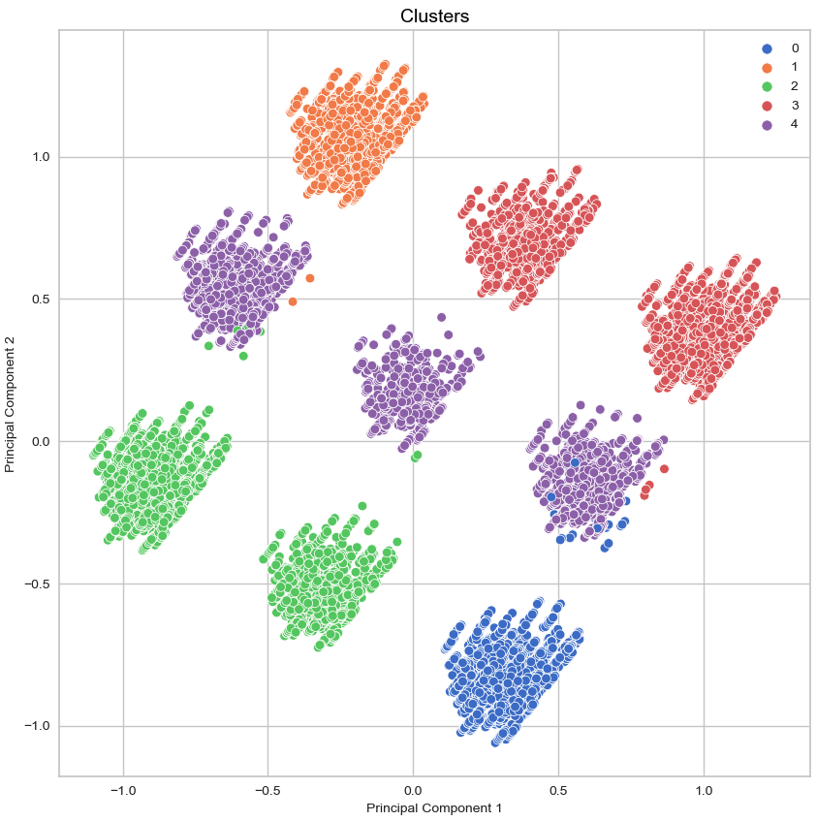
K-Means Clustering Analysis

Slide 4
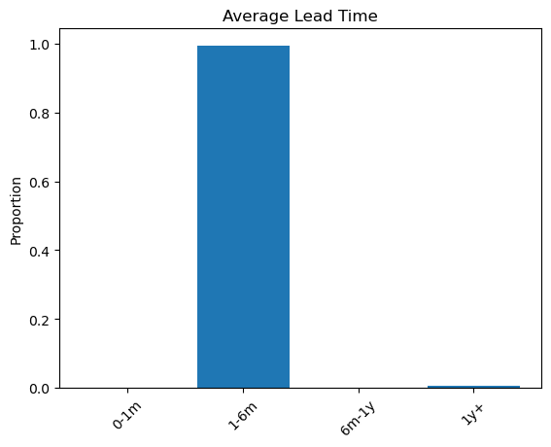
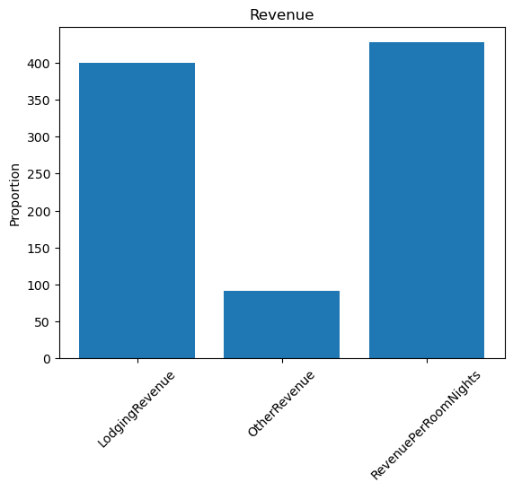
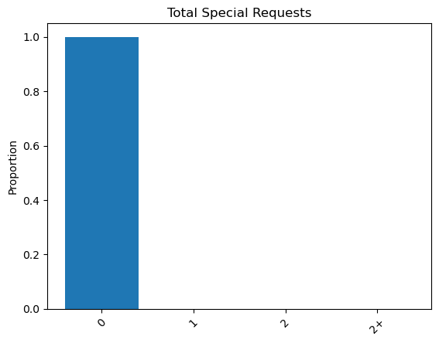
Cluster 0
Well Planned Spenders
99% of customers book 1-6 months in advance
Customers with higher spending propensity, characterized by longer stays or more expensive room choices

Slide 5
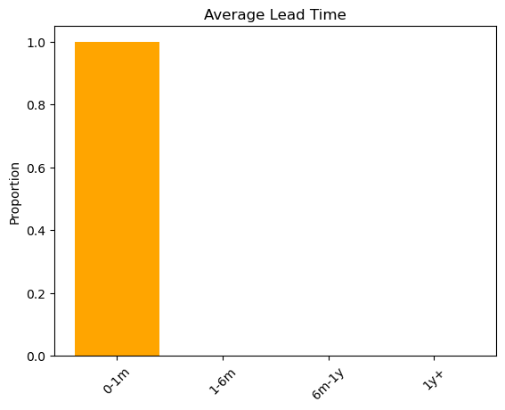
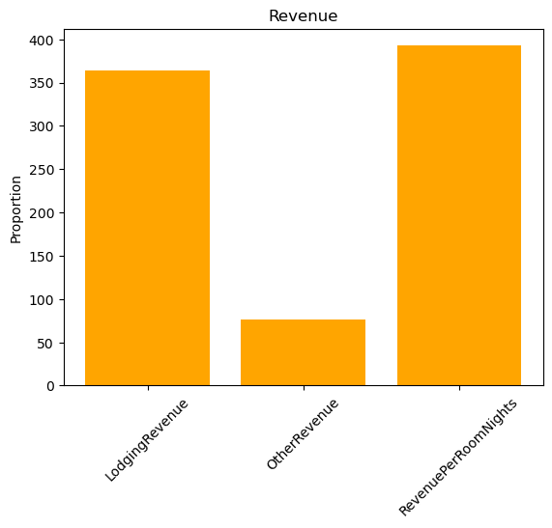
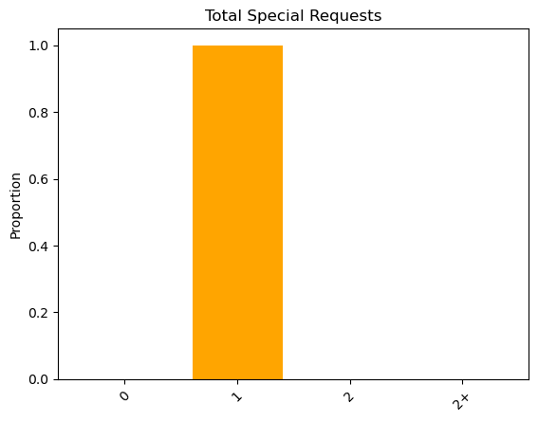
Cluster 1
Value conscious Last-Minute Travelers
Strong preference for last minute bookings
Lower revenue generation and one special request

Slide 6
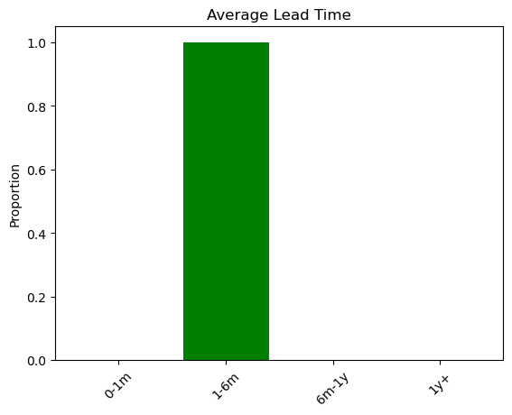
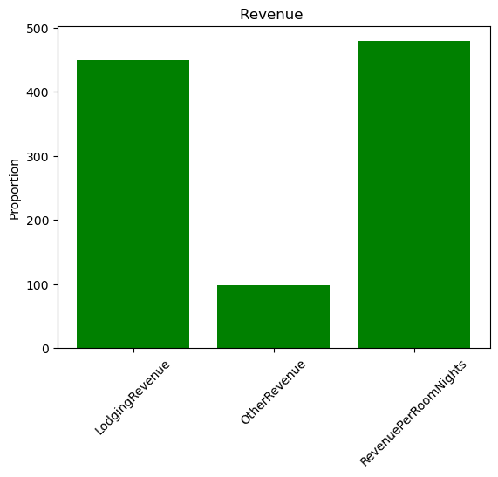
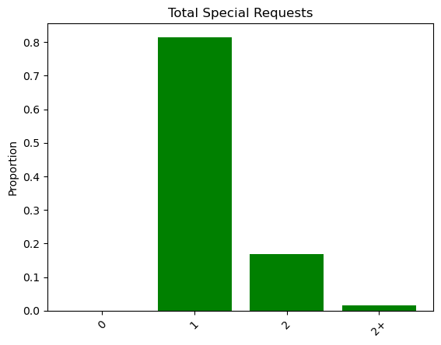
Cluster 2
Well Planned Big Spenders
Strong preference for advanced bookings
Largest revenue generation

Slide 7
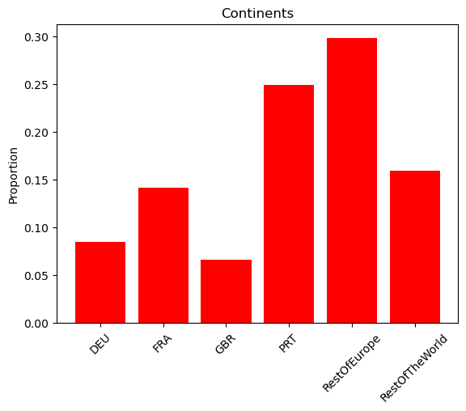
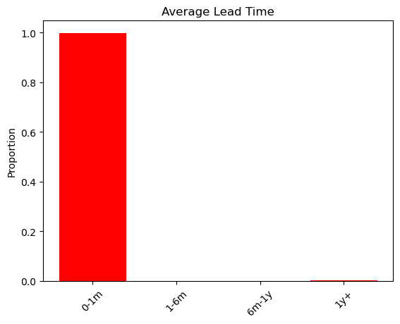
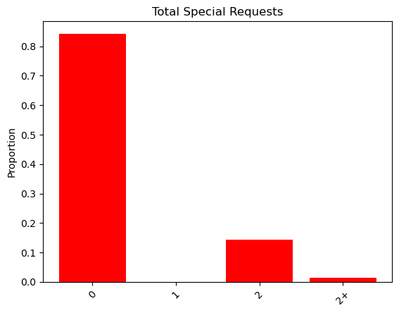
Cluster 3
Low spenders with no planning
The customers with the lowest expenditure per stay
A typical age distribution among the clients

Slide 8
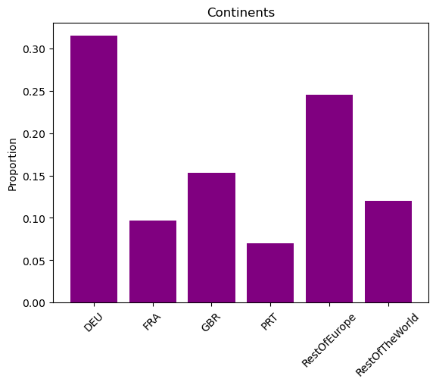
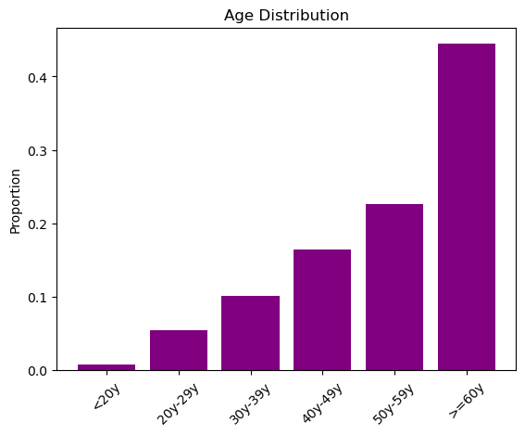
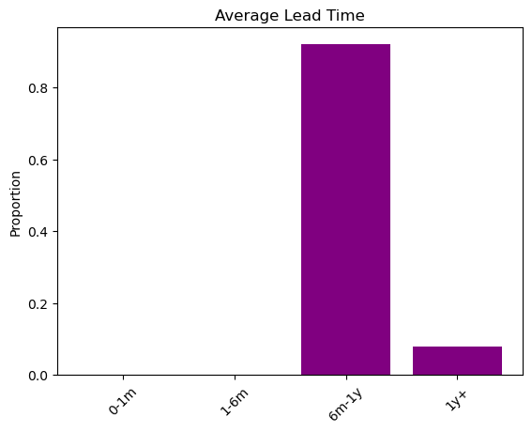
Cluster 4
Meticulous Long-Term Patrons
Half of these clients make a special request
A client with moderate spending but leading in revenue in the 'other revenue' category

Slide 9

Marketing strategies

Slide 10
Cluster 0 – Well Planned Spenders
Personalized Planning Assistance
Early Purchase Discount
Special Request Enhacements

Slide 11
Cluster 1 – Value-Conscious Last-Minute Travelers
Last Minute Deals
Flexible Cancellation Policies
Quick Booking Incentives

Slide 12
Cluster 2 – Well Planned Biggest Spenders
Exclusive Booking Packages
Early Access Benefits
Personalized Recommendations

Slide 13
Cluster 3 – Low Spenders With No Planning
Cost-Effective Bundles
Last-Minute Discounts
Simplified Booking Procedure

Slide 14
Cluster 4 – Meticulous Long-Term Patrons
VIP Loyalty Programs
Tailored Experiences
Extended Stay Discounts

Slide 15
Conclusions

